Slide 1



Get Creative, Get Connected, Get Coding!

Slide 2

Introductions

Slide 3

Tic-tac-toe Exercise: Can you instruct the computer how to play?

Slide 4
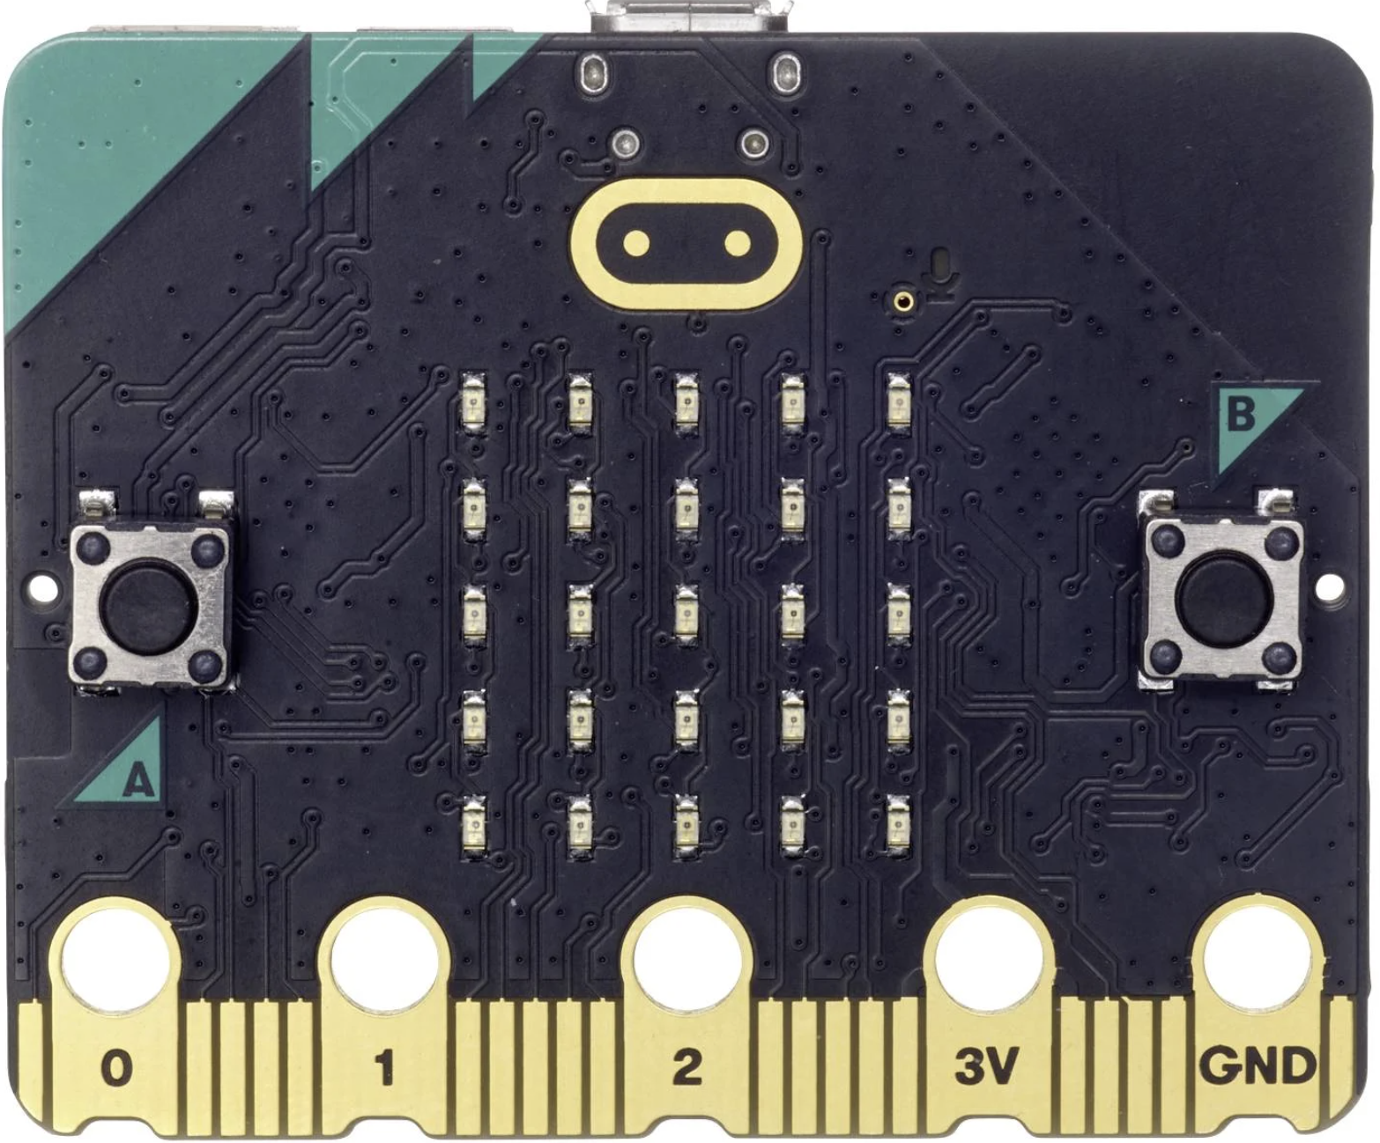
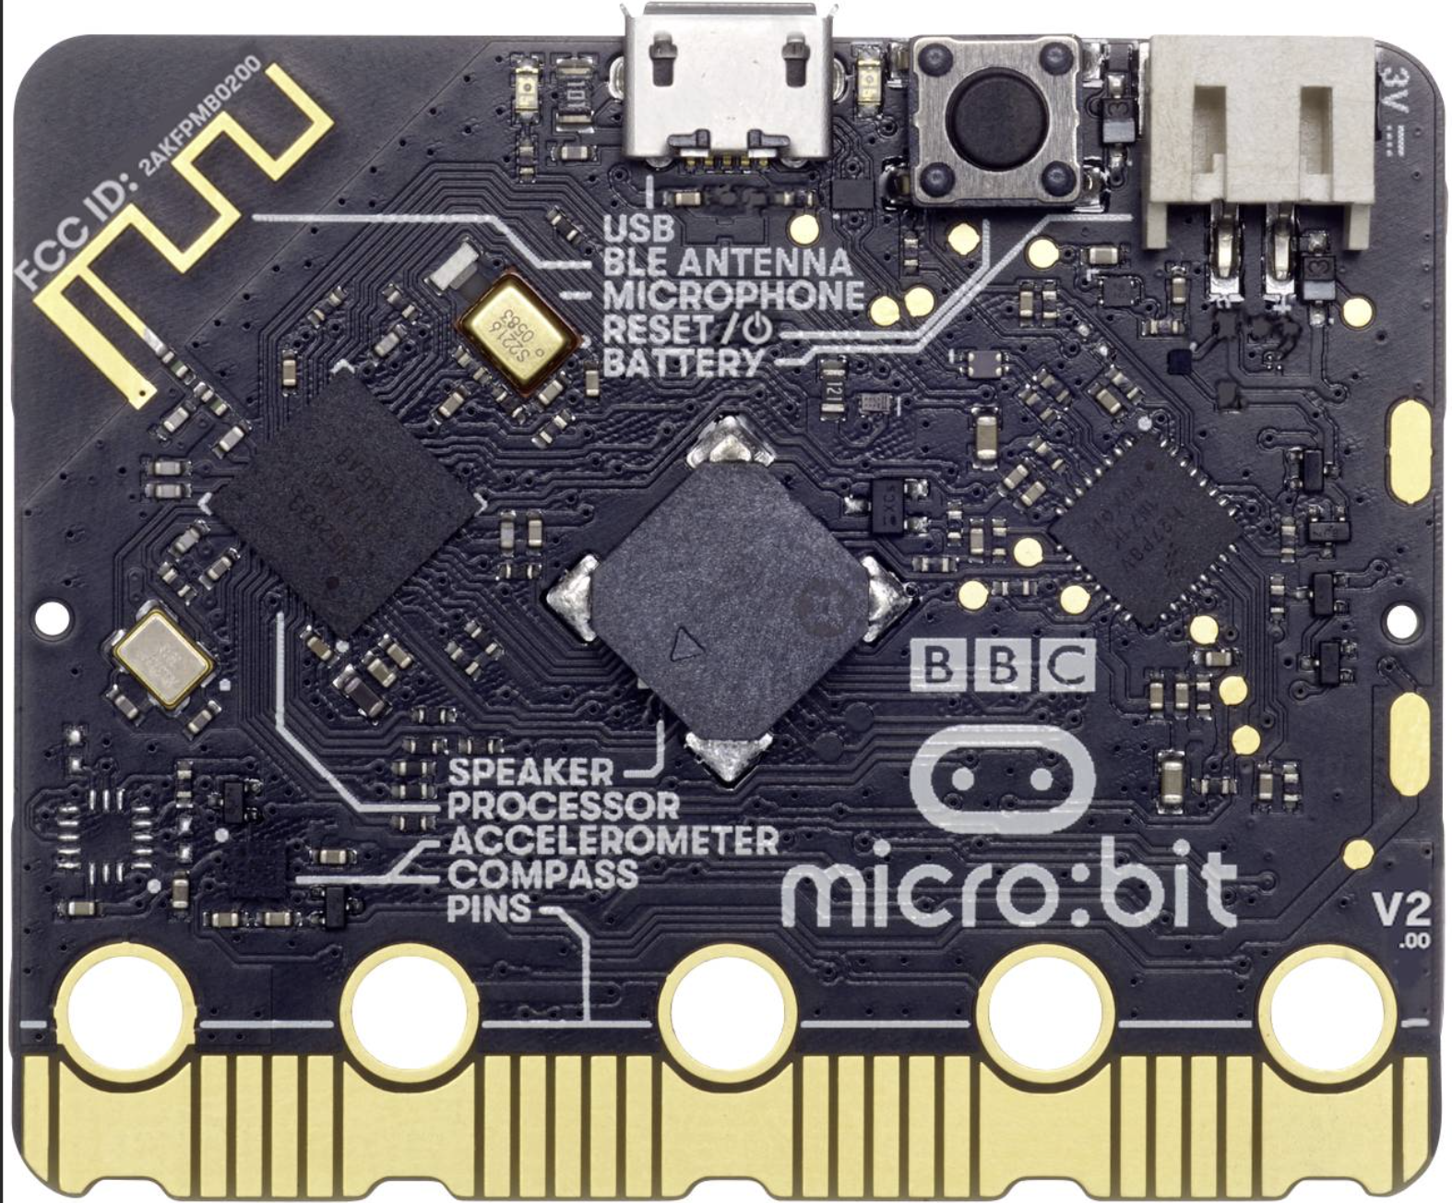
What can I do with a micro:bit?
Radio
Microphone
Thermometer
Light Sensor
Reset button
LED lights
Mini USB port
Touch Sensor
Button A
Button B
Battery connector
Speaker
Accelerometer
Compass
Connection pins
Connection pins

Slide 5
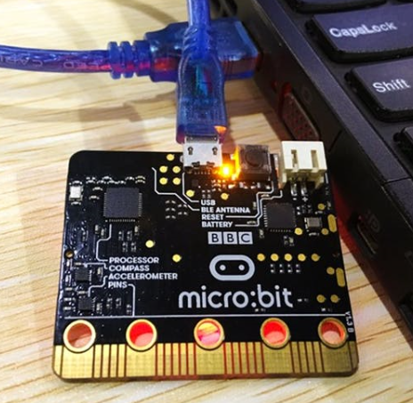
Let’s Code!
Open a browser, and navigate to
makecode.microbit.org

Slide 6

Thank You

